Slide 1
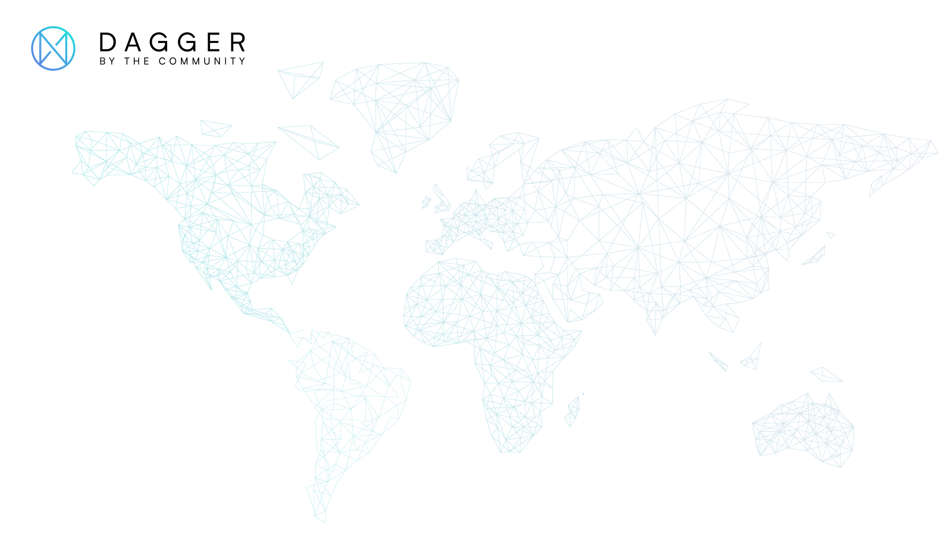
XDAG: PoW + DAG
frozen@xdag.io
https://github.com/xrdavies

Slide 2
State-of-The-Art
Bitcoin
Ethereum
EOS
Blockchain tech is facing problems
???

Slide 3
State-of-The-Art
Layer1
Layer2
DAG
Consensus PoS/DPoS
Side Chain
Nano
IOTA
State Channels
Shading
Byteball
Multi Chains
XDAG

Slide 4
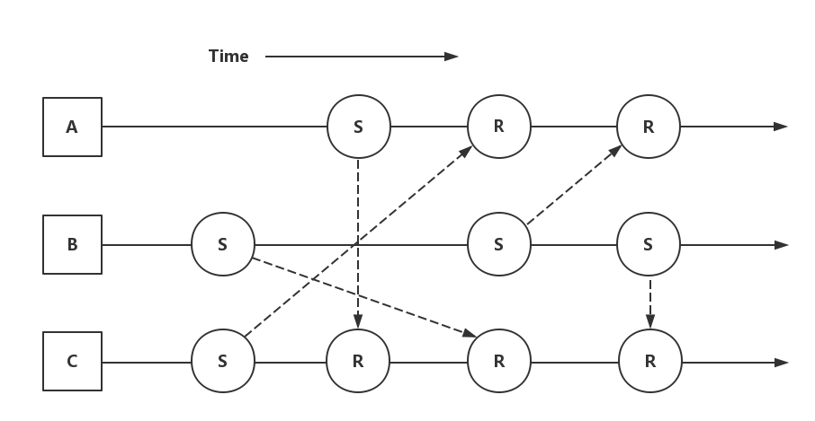
NANO

Slide 5
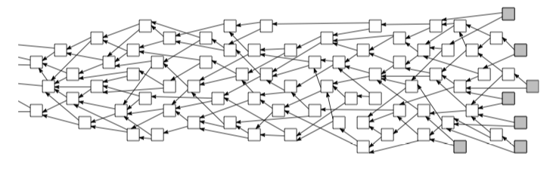
IoTA

Slide 6
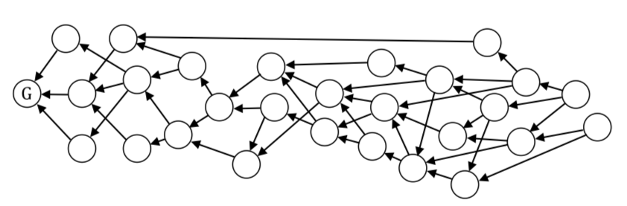
Byteball

Slide 7
DAG – Directed Acyclic Graph
XDAG is another innovation technology to solve problems

Slide 8
XDAG: A new DAG-based cryptocurrency
The first mineable DAG
No Pre-mine
No ICO
Community driven

Slide 9
DAG - Directed Acyclic Graph
PoW
Decentralized
High TPS
Block = Transaction = Address
Blockchain tech friendly

Slide 10
Tx
Tx
Tx
Tx
Tx
Tx
Tx
Tx
A
Tx
Tx
W
Tx
A
W
W
W
M
M
A
M
M
M
A
W
Tx
W
Tx
Tx
Tx
Tx
Tx
G
Tx
W
Tx
Tx
Tx
Tx
Tx
Tx
Tx
Tx
Tx
W
Tx
Tx
Tx
W
A
W
M
W
M
M
W
M
M
W
W
A
Tx
A
Tx
A
Tx
Tx
Tx
Tx
Tx
A
Tx
Tx
Tx
Tx
Tx
Tx

Slide 11
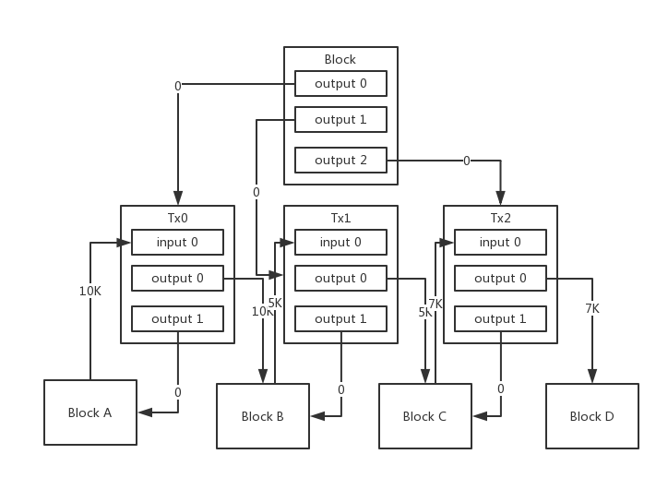
UTXO
XDAG UTXO

Slide 12
Blockchain

Slide 13
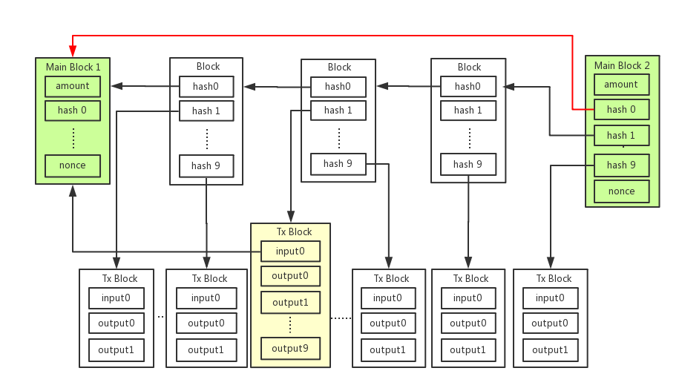
XDAG

Slide 14
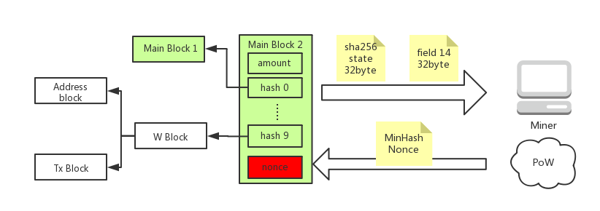
PoW: The Spirit of Blockchain

Slide 15
Miner uses double sha256 to find minimal hash
Node generates main block based on minimal hash every 64s
Determine main chain based on difficulties of generated main blocks

Slide 16
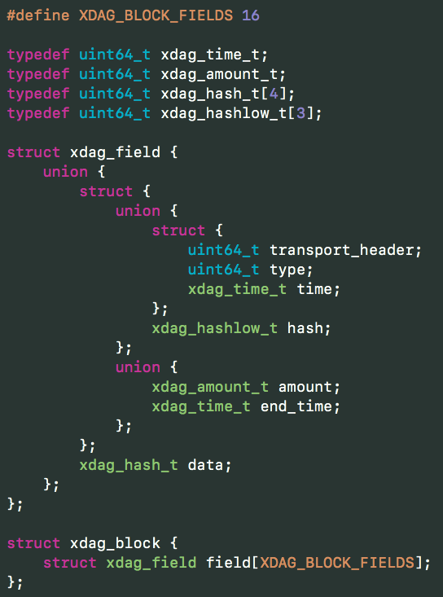
Block
persistent storage
512 Bytes
5 Forms
16 types
16 fields

Slide 17
8 Bytes | 8 Bytes | 8 Bytes | 8 Bytes
transport header | type | time | amount
Output hash |  |  | amount
Output hash |  |  | amount
Input2 hash |  |  | amount
Input3 hash |  |  | amount
 |  |  | amount
Output hash |  |  | amount
Output hash |  |  | amount
Output hash |  |  | amount
Public Key 1
Output sign R 1
Input sign S 1
Public Key 2
Input sign R 2
Input sign S 2
Block example
512 Bytes
1 header
15 fields
Storage on disk
max limit 10 transactions

Slide 18
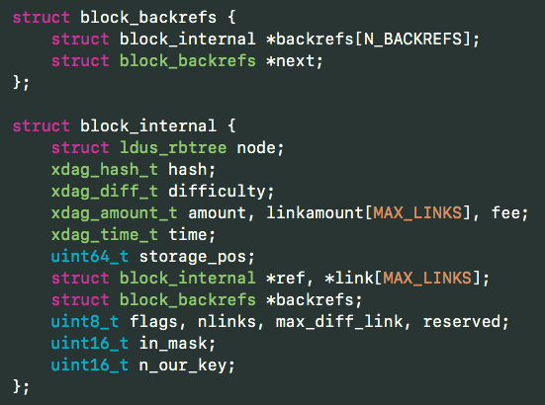
Internal Block
Store DAG
To construct account system

Slide 19
Difficulties & Hash rate
Miner use double sha256 to find minimal hash
Node generates main block based on minimal hash every 64s
Determine main chain based on difficulties of generated main blocks

Slide 20
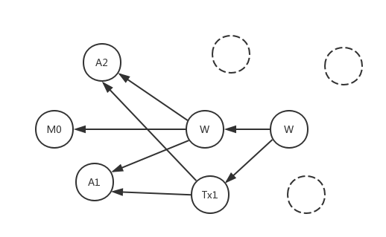
Simple Transaction case
A1 A2 address
M0 main block
Tx1 transaction
W witness block

Slide 21
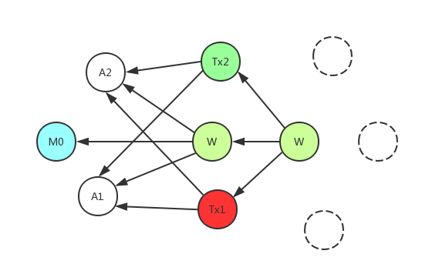
Double spend 1
double spend case on same node
A1, A2 are wallet block
Tx1, Tx2 are Txs from A1 to A2.
Detected by ref orders directly.

Slide 22
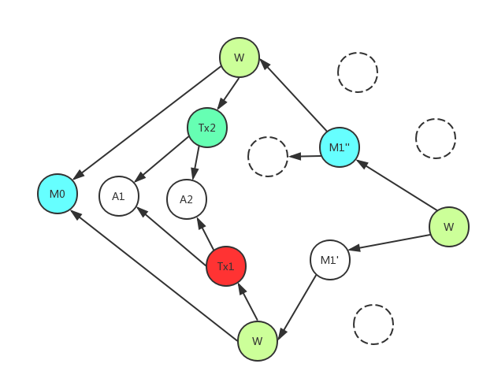
Double spend 1
double spend case on different nodes
A1, A2 are wallet block
Tx1, Tx2 are Txs from A1 to A2.
Detected by ref orders and block difficulties.

Slide 23
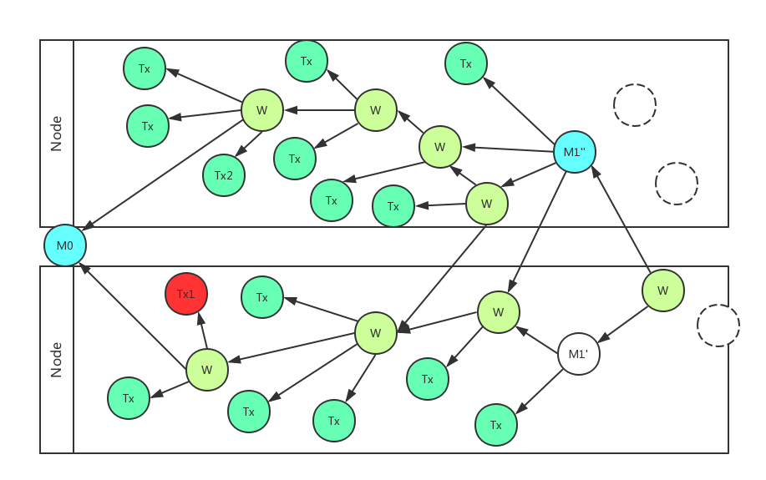
High TPS
each node process its transactions and construct self sub-DAG. Then merge them together through mined main blocks.

Slide 24
Algorithm : how to validate transaction
Time of block A is not less than the Dagger era;
Time of each input or output of block A is less than the time of block A;
Each input or output of block A is a valid block;
Sum of all input amounts of block B is less than power(2,64);
Sum of all output amounts of block B plus its fee is less than power(2,64);

Slide 25
Algorithm : how to validate transaction
If there is at least one input and sum of all inputs must be not less than sum of all outputs plus fee; otherwise sum of all outputs must be zero;
For each input B of the block A there are public key K and input or output signature S in the block A and output signature T in the block B such that signature S is obtained from block A using key K and signature T is obtained from block B using the same key K (informal description: only owner of block B can withdraw money from it).
Number of output signature fields must be even instead of number of input signature fields may be odd; in this case the last input signature field may be used as nonce which can be altered without rebuilding any signatures.

Slide 26
Algorithm : how to sort transactions
Block referenced by a main block is ahead of block not referenced
The smaller i-referenced block to the same common block is ahead
The referenced block is ahead of linked block

Slide 27
Transport:
Node only broadcast blocks generated by itself
Node request other blocks from other nodes

Slide 28
Security
ECDSA secp256k1 for signing
Semi-symmetric for transport

Slide 29
Community Driven
No ICO, No Pre-mining, No investment, No capitals
Community members are from different social channels
Current developers are from different countries who never met each other

Slide 30
Current State
Main net started since Jan 5th 2018
Current release 0.3.0
GUI wallet for Windows, Mac and Linux is Ready
Android Wallet is Ready
iOS Wallet is Ready
RPC in progress
8 exchanges listed XDAG
Golang Version in progress
Anonymous Trading in progress

Slide 31
The Future
Hash algorithm adjustment – Q1 2019
Anonymous Trading – Q2 2019
Smart Contract – Q3 2019
Full Wallet – Q1 2019

Slide 32
How to Join & Help Community
Everyone related to XDAG is part of community
Spread XDAG
Discuss proposal
Report issues
Translation
Contribute code

Slide 33
Thank you!
Thanks to all developers!
Evgeniy, Frozen, sgaragagghu, AnythingTechPro
Bill, Solar, ssyijiu, trueserve, Toneyisnow, czslience, kbs1
rubencm, Jimmy, mathsw, Wendy
Thanks to all Miners, Pool Owners, Community Members
and
other Contributors

Slide 34
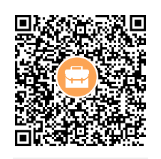
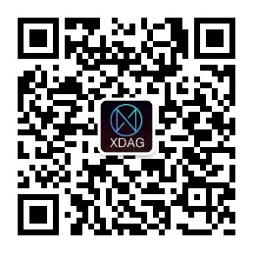
Dev QQ Group
WeChat Official Account

